Slide 1

SNIPE TEAM
1 December 2017
www.snipe.co.in
1
Notes:
1

Slide 2


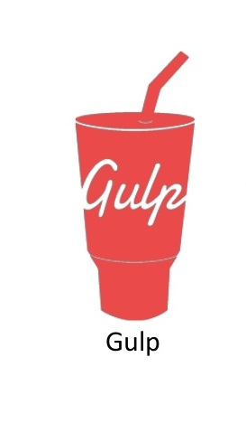
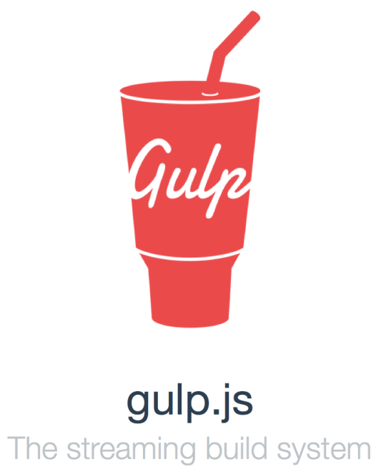
GRUNT AND GULP

Slide 3
CONTENTS
What is Grunt ?
Why Grunt?
How do I start ?
Installation
Advantages
Workflow

Slide 4
What is gulp ?
Why gulp ?
How do I start ?
Installation
Difference between Grunt and Gulp

Slide 5
INTRODUCTION
Grunt is a javaScript task runner.
Open source .
Repetitive tasks like minification,
Compilation,Unit testing,Linting ,Etc
are done.
Easy to use.
Hundreds of Plug-ins available.
NodeJS and NPM has to be installed prior to GRUNT.

Slide 6
TASKS
Replace Script in HTML File.
Concatenating / Minifying the files.
JS Hinting
Unit Testing.
Image Optimisation
Hundreds of Plugins are available.

Slide 7
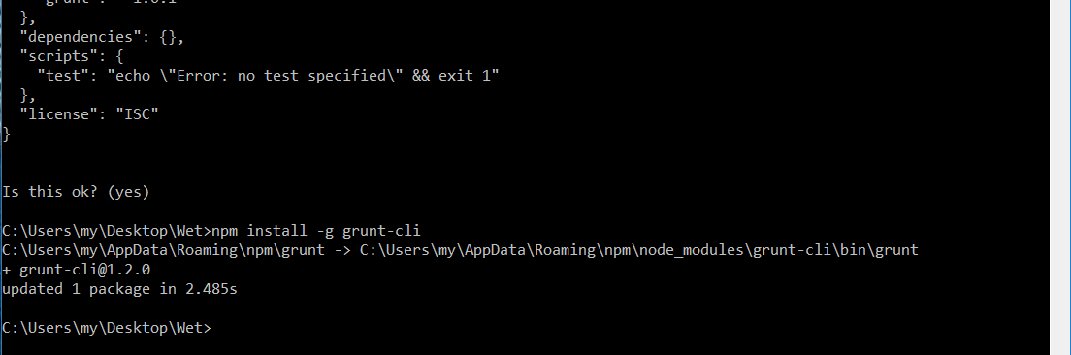
GRUNT INSTALLATION
Npm has to installed prior to installation of Grunt Installation.
Run : npm install-g grunt-cli

Slide 8
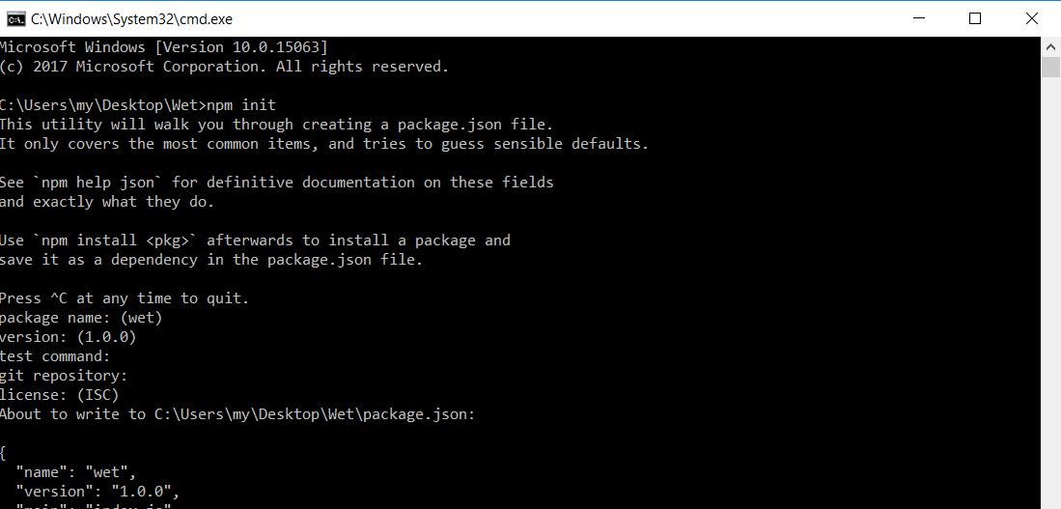
Package.Json Installation
To install Package.json, we need to intiate npm
Run : npm init

Slide 9
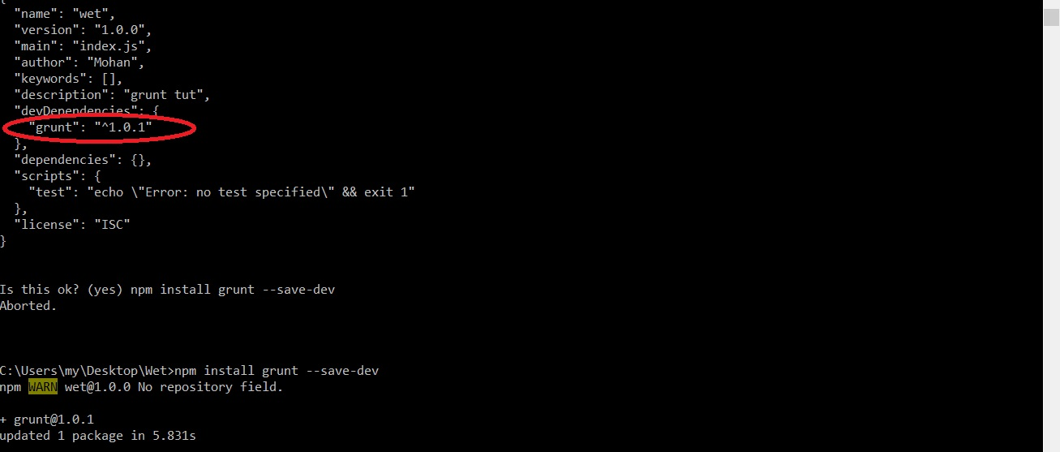
Run: npm install grunt --save-dev
This will install grunt dependency in package.json file
Continuous feedback relating to coding, build failures and test status were not available.

Slide 10
GRUNT PLUGINS
contrib-uglify
Contrib-cssmin
Contrib-concat
Grunt contrib-watch
Minify Javascript file.
Minify CSS File.
Concatenate files.
Run test whenever watched file an change

Slide 11
ADVANTAGE
Grunt unifies the workflow of web developers.
It speed up the development workflow and enchances the performance of projects.
Grunt includes built-in task that extends the funtionality of plugins and Scripts .

Slide 12
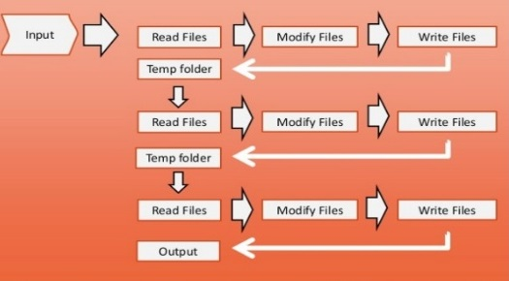
WORKFLOW

Slide 13
Gulp Introduction
Gulp is a task runner that uses node.js as a Platform.
Front-end development tool.
Task automation in JavaScript.
Streaming build system.
Demand on large projects.
13

Slide 14
WHY GULP
HTML and CSS Minification.
Concatenating Library files.
Easy to understand and build the gulpfile.js.
Compiling the SASS files.
Hundreds of Plugins available.
Repetitive ,tendious tasks.

Slide 15
GULP PLUGINS
gulp-minify-css
gulp-concat
gulp-iconfont
gulp-source maps-cd
Used to merge and minify all CSS Scripts.
Used to concatenate the files.
Create icon font for Several SVG icons.
gulp sourcemaps cdn is fast,global content delivery network(cdn).

Slide 16
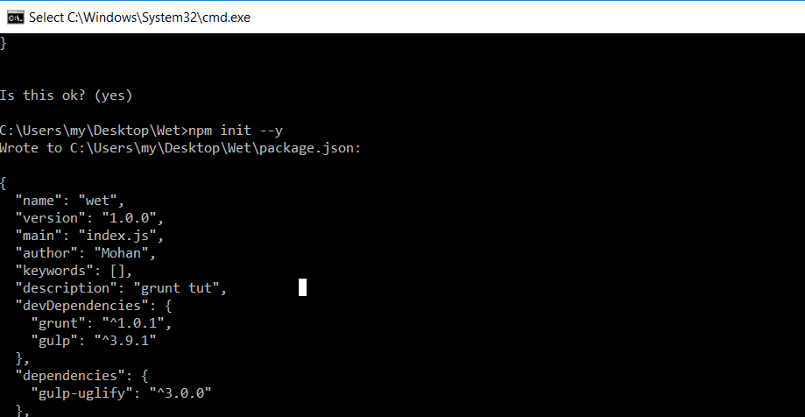
GULP INSTALLATION
Run : npm install
- Creates node module.
Run : npm init
- Creates package.json file.

Slide 17
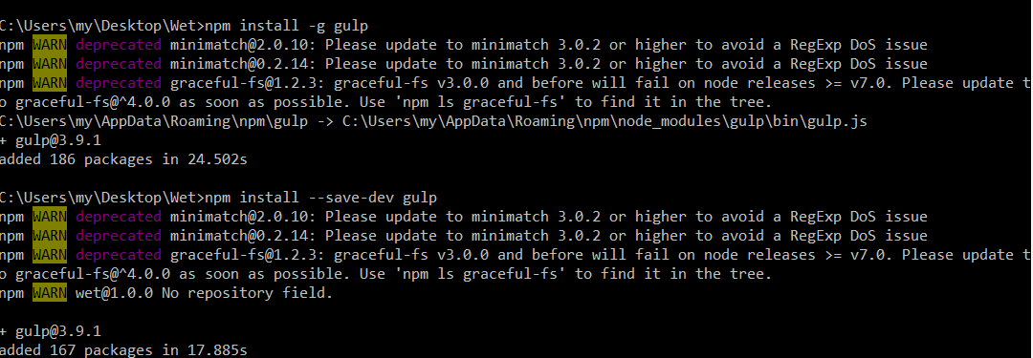
Run : npm install –g grunt
-npm will be installed globally in the system.
Run:npm install --save-dev

Slide 18
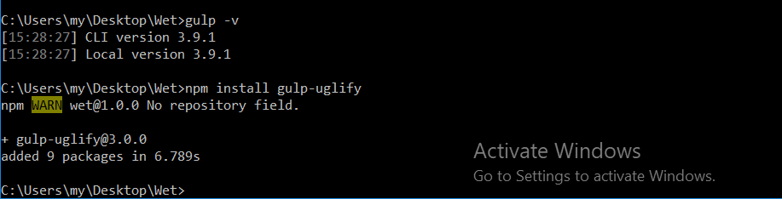
Run : gulp –v
- Views the version of the Gulp.
Run : npm install gulp-uglify
- Validate Javascript file.

Slide 19
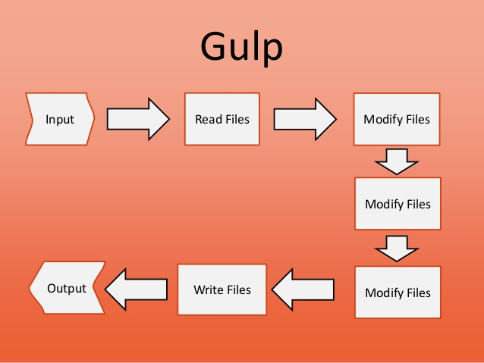
WORKFLOW

Slide 20
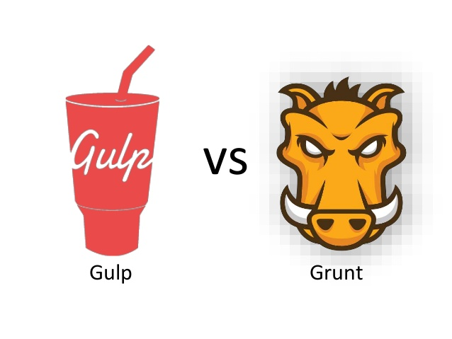
Difference between Grunt and Gulp

Slide 21
Difference between Grunt and Gulp
The Difference between the Grunt and Gulp is how they
Accomplish the tasks.
The Grunt uses the plugin to accomplish multitask at the
same time, plugin creation process is very different,
depends on which tools using.
The first significant difference is that Gulp has been
been designed to use a series of plugins that each do
a task.

Slide 22
Building Responsivity:-
Gulp:- Uses streams from Nodejs.
Grunt:- Uses Configuration based approach
No any streams uses, some files are stored
temporarily.
So Gulp builds faster than grunt.

Slide 23
Q & A

Slide 24
Thank You

